Slide 1



Government Measures & Economic Indices:
Descriptive and predictive analysis, from data science and machine learning.
Associate Data Science Team, Mayo 2022.
Researchers: Pedro Vernengo & Rufino Martín.
Supervision and Direction: Joaquin Aranguren y Jose Lopez.

Slide 2
General Objectives
Obtain valid and timely information, both descriptive and predictive, on the behavior of the world economy in times of health crisis..
Produce visualizations and comments that facilitate the communication of said observations.
Develop a machine learning model capable of predicting the value of economic indices.

Slide 3
Specific Objectives
- Perform descriptive statistics on the entire dataset.
- Obtain univariate analysis of all the Indices.
- Analyze the variation in the price of commodities and stock market indices in relation to government measures by COVID19, within the 2019-2022 time frame.
- Exploration of relationships between the variables and generation of visualizations on the variation of the price of commodities, in order to nurture potential explanations.

Slide 4



Datos Utilizados
“Government Measures C19”
Definition: Health, economic and social executive measures in 168 countries during the Covid19 pandemic.
Operationalization: Sets of Variables defined and operationalized by the University of Oxford.
Source: University of Oxford.
“Commodity Indices Price”
Definition: Grouped price of Commodity Indices (Metals, Industry, Agriculture, Food, Energy).
Operationalization: Counting and indexing of historical prices.
Source: International Monetary Fund.
“Price of Stock Market Indices”
Definition: Prices of the major World Stock Indices.
Operationalization: Counting and averaging of historical prices.
Source: Market Watch website.

Slide 5
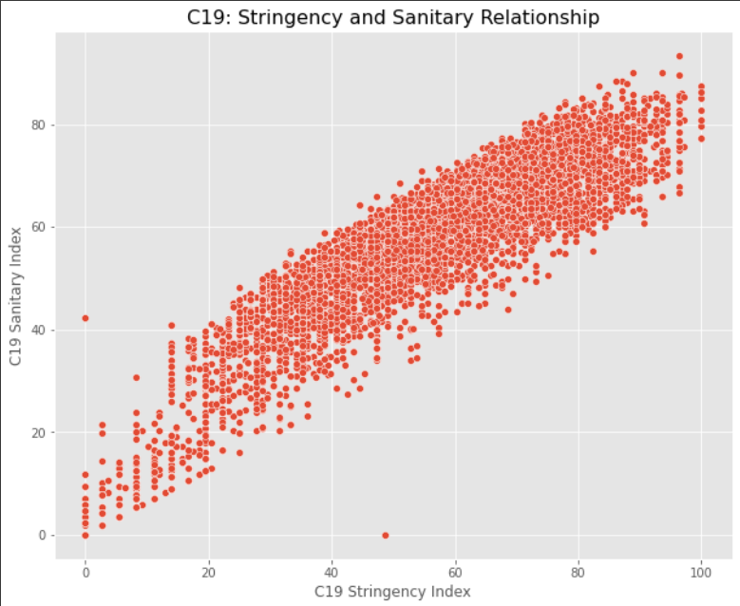
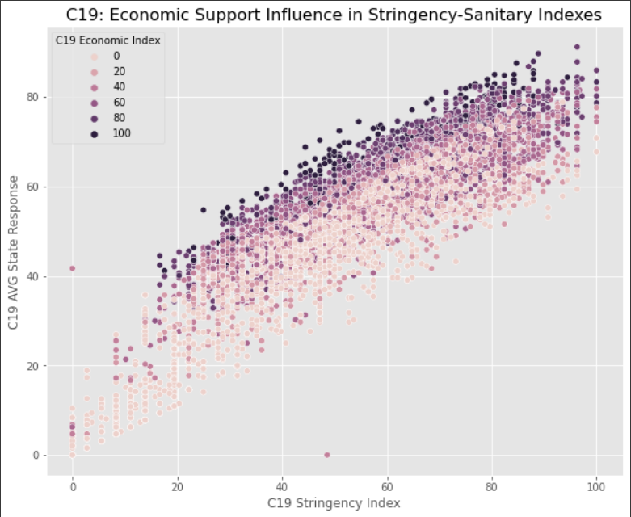
Data Exploration: C-19 Government Measures

Slide 6
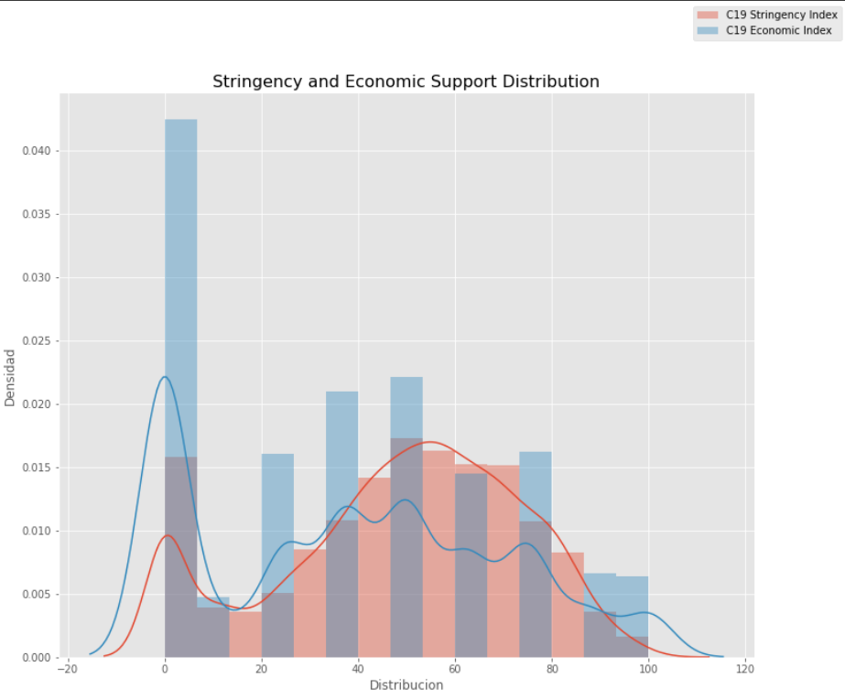
Data Exploration: C-19 Government Measures
Observations
The indexes of government measures for Covid19 are closely related to each other. This makes sense:
1) because they share some of the indicators of which they are made up.
2) because the indices reflect executive policies, which generally increased or decreased jointly and in response to the increase in cases/infections.
The influence of economic support can also be seen in the increased rigor and government response.

Slide 7
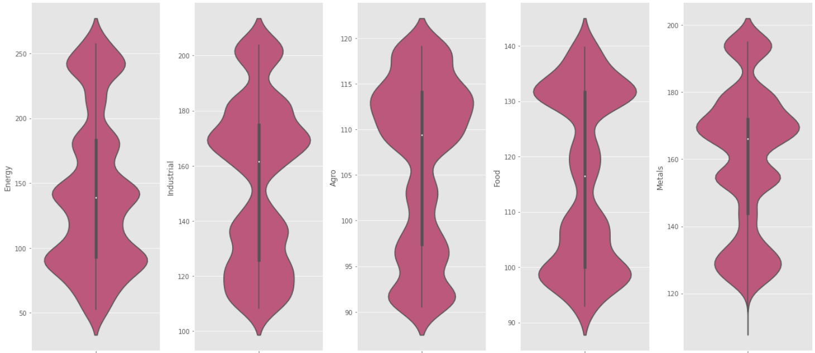
Data Exploration: Commodities’ Prices

Slide 8
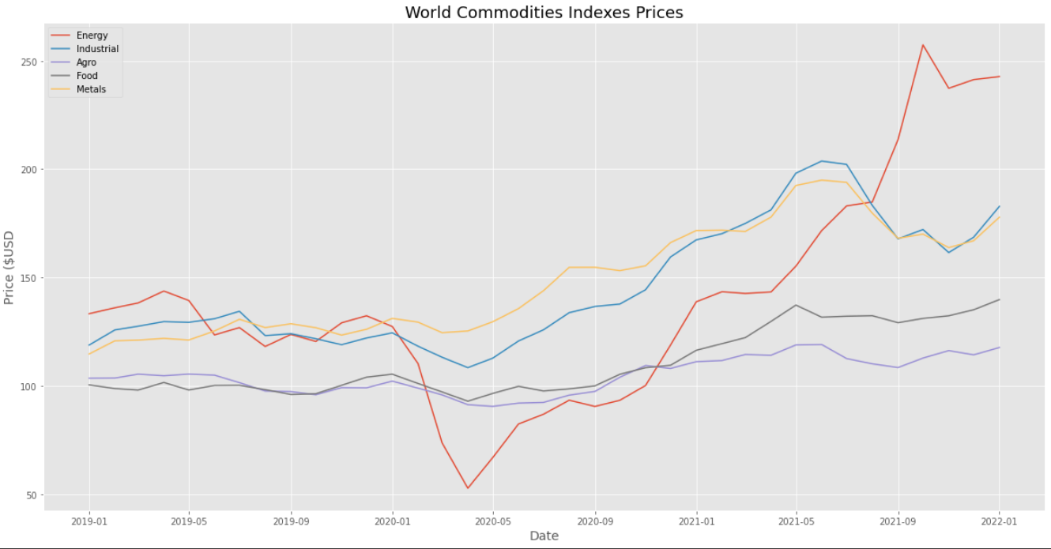
Data Exploration: Commodities’ Prices

Slide 9
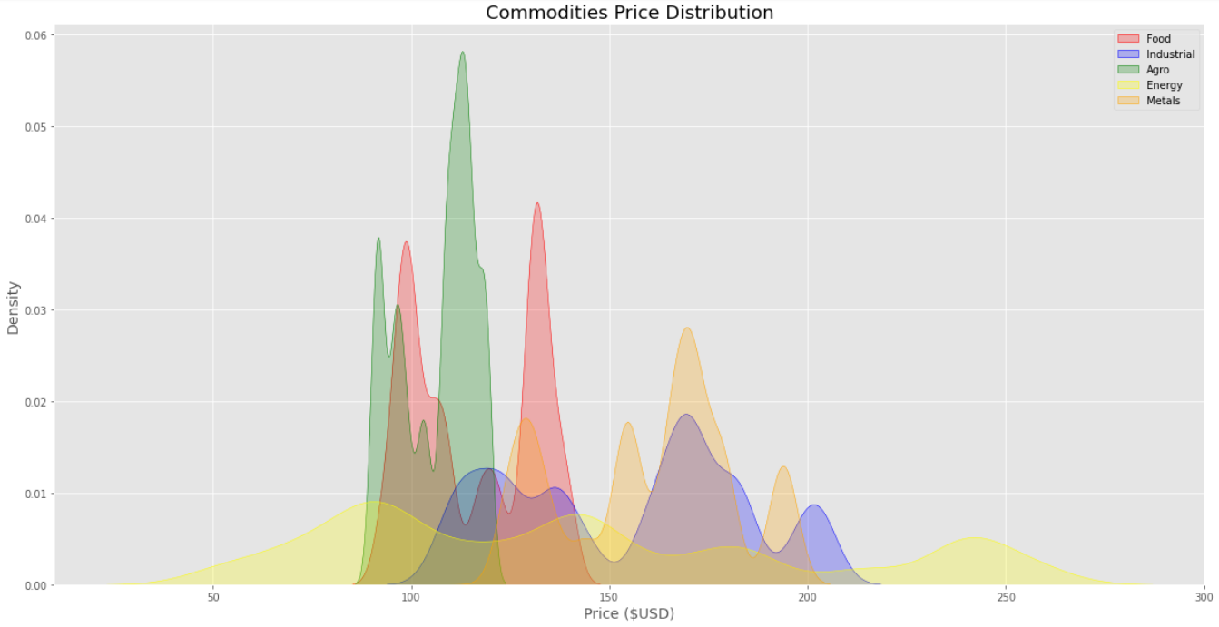
Data Exploration: Commodities’ Prices
Observations
Although all the commodity indices register a similar megatrend for the period studied (up), they also exhibit a different behavior among themselves:
- The Industrial Index and the Metals Index have a great relationship.
- The Food Index and the Agro Index have a great relationship.
- The Energy Index stands out for its own or zigzag behavior, registering the maximum low and the maximum high among the indices, that is, it is the most volatile.

Slide 10
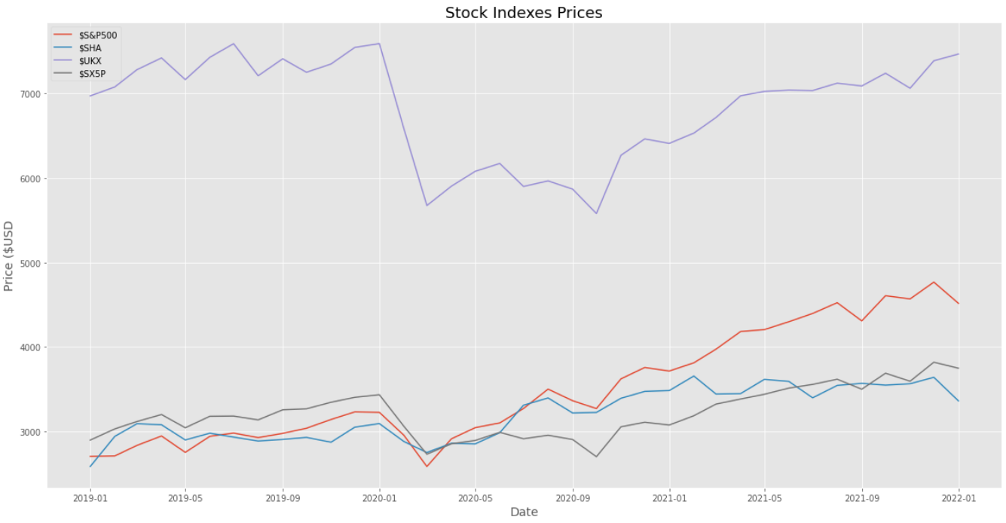
Data Exploration: Stock Prices

Slide 11
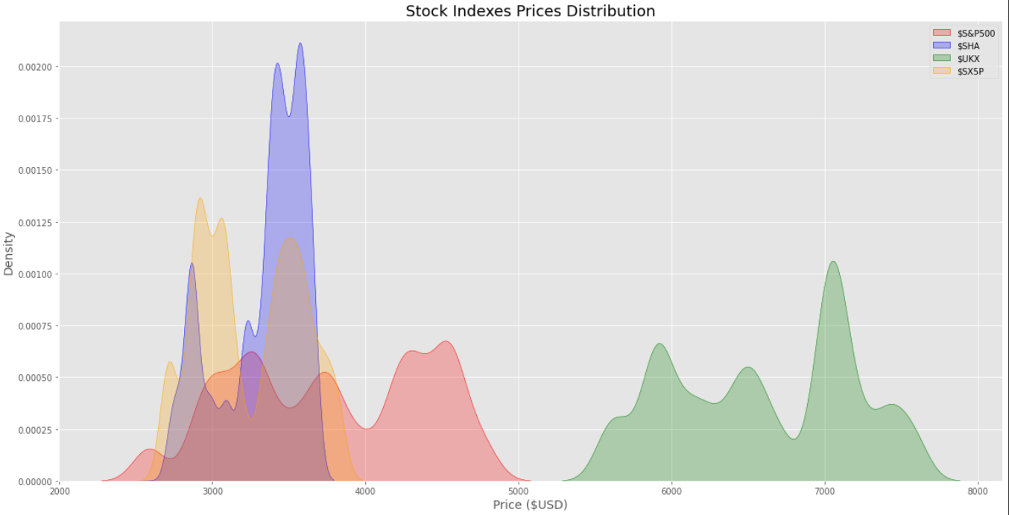
Data Exploration: Stock Prices
Observations
A common pattern can be verified for the 4 Stock Market Indices, even belonging to different regions.
This fulfills the requirement of using them, in a unified way, as a representative financial variable at a global level.
Going forward, the analysis will use an average that we have made of these indices, called the "Stock Market Average".

Slide 12
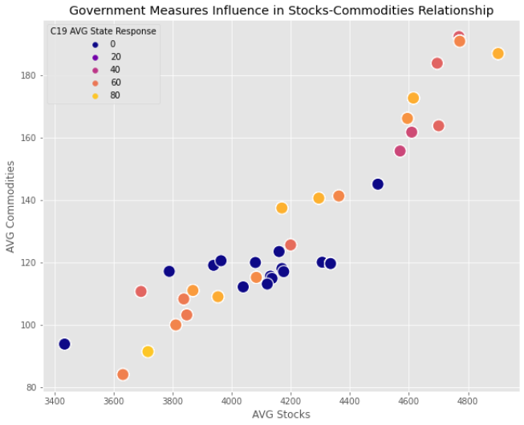
Data Exploration: Conglomerate Indexes Analysis
Average-Power
Using the averages that group the values for the Commodities, Stock and Government Indices, we observe their correlation.
The presence of State Response C19 is high in the Commodities-Stock market relationship, or, in other words, it registers high values throughout the shared distribution of said variables.

Slide 13
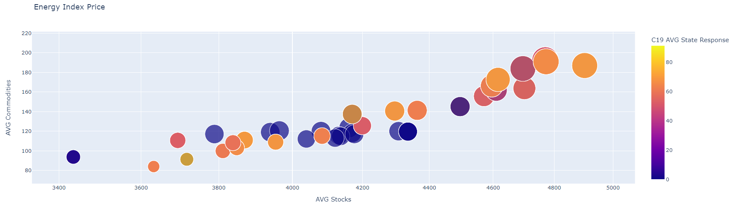
Primary Objective Definition: Energy as Target
“Energy prices will decide our speed of progress and our ability to tackle urgent problems”
"That the advances of Industry 4.0 can reach all corners of the world requires accessible and cheap energy"
“In view of the latest war events in Eastern Europe, the correct study of this Index is a top priority”
Comments of the Assembled Council, September 2021.

Slide 14
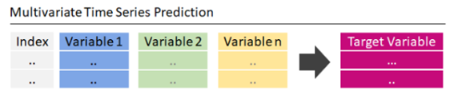
Implementation of a Multivariate Machine Learning Model
Dependent variable, Target or Explained: Energy Index.
Independent, Features or Explanatory Variables: Superscripts such as Stock Market Average, Commodities Average and State General Response C19.
Purpose of the Model: Price Prediction

Slide 15
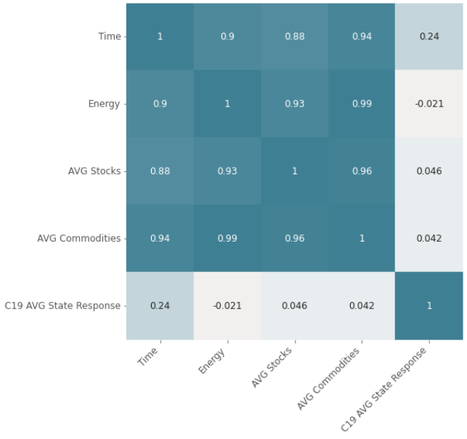
Implementation of a Multivariate Machine Learning Model
Heat Map
Visualization of the existing correlation between the variables used for the machine learning model.
It is observed that government measures have the lowest levels of correlation, although, however, they are not insignificant.

Slide 16
Implementation of a Multivariate Machine Learning Model
Models’ Specs
After training it, error measurement tests are produced:
The mean test error (RMSE) is 7.56
The mean of the absolute error of the test (MAE) is 6.34
A decrease in the mean error is observed when adding the selected independent variables.
The accuracy of the model is 98%.

Slide 17
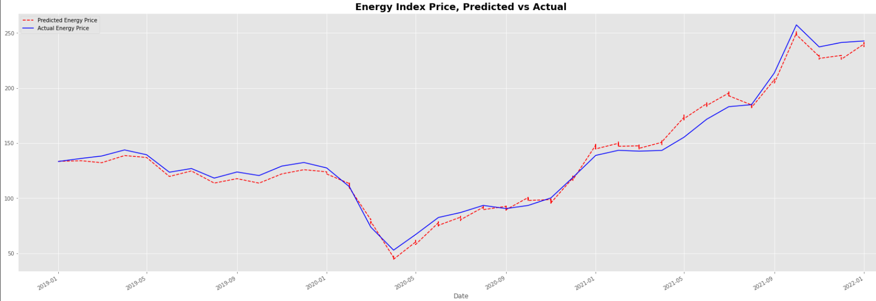
Implementation of a Multivariate Machine Learning Model
Accuracy Visualization
The model uses a Training set, which represents 80% of the data. The model is then tested with the Test set, which comprises the remaining 20%. Above, the visual comparison of effectiveness achieved.

Slide 18
Model Specs
[No. Observations] : The model made 6249 observations, which is the size of our sample.
[std error] : The standard deviation for the constant is 2, and for the variables, values close to zero 0.
[P>t] The P value is the probability that the null hypothesis will be true, that is, that the statistical results do not follow the stated causality. Since here they are 0.0 and the t-values are dissimilar to each other (confirming that X has a significant impact on Y), the null hypothesis is discarded.
[0.025 - 0.975] : Values within these ranges are rare.
[R-squared] : It is the coefficient of determination that indicates what percentage of variation of the dependent variable is explained by the independent: In this case, it is 0.98 or 98%.
[Optimizaciones] : potential to increase the accuracy to 99.9% in its prediction of the Energy value, as long as the indicated parameters and hyper parameters are modified.

Slide 19
Conclusions
The realization and optimization of the presented model has solid foundations and high levels of validity to continue its development.
The model is potentially applicable at any index, as long as the corresponding prior correlation and validity study is carried out.
A battery of prediction models would be extremely useful to favor strategic decision-making.
Its implementation in a data pipeline connected to official and up-to-date information sources should not pose any difficulties.
The designed visualizations also serve to form dashboards for data analysis.

